Slide 1






Personal finance management
“a simple and effective to manage your finances”

Slide 2

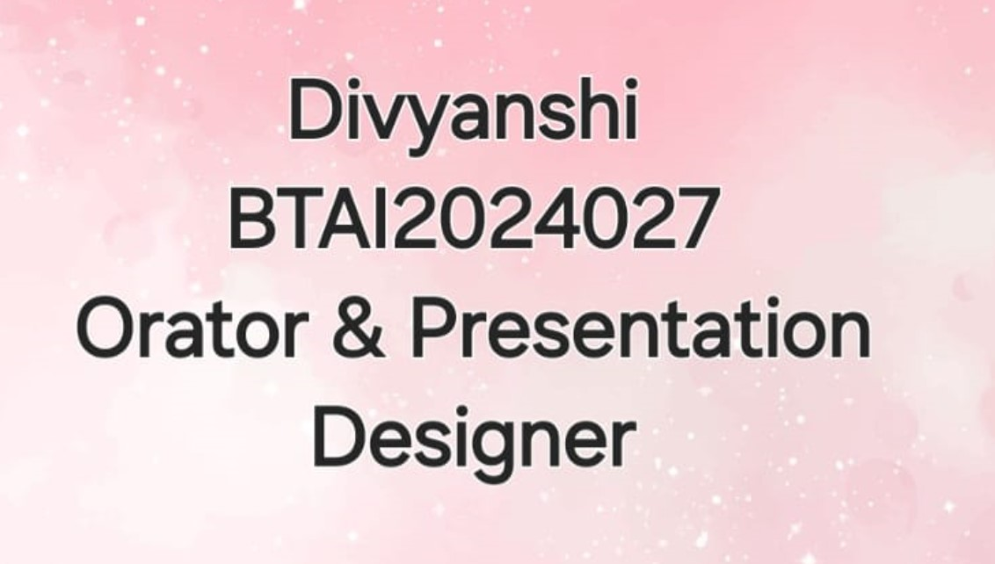
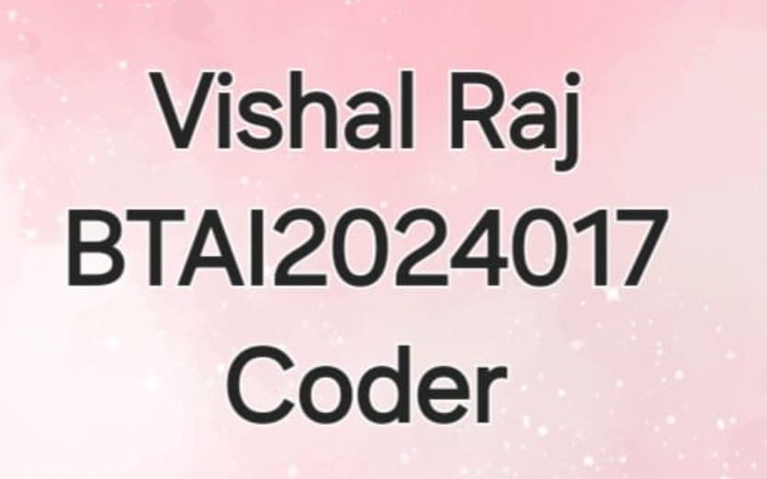



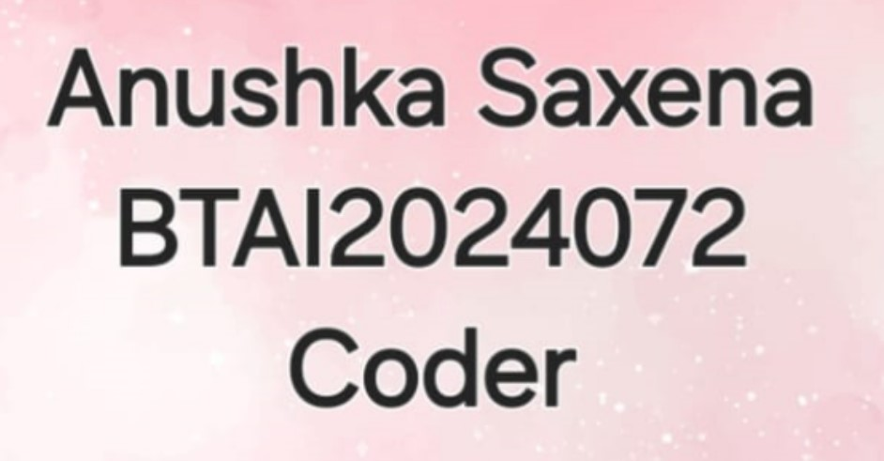


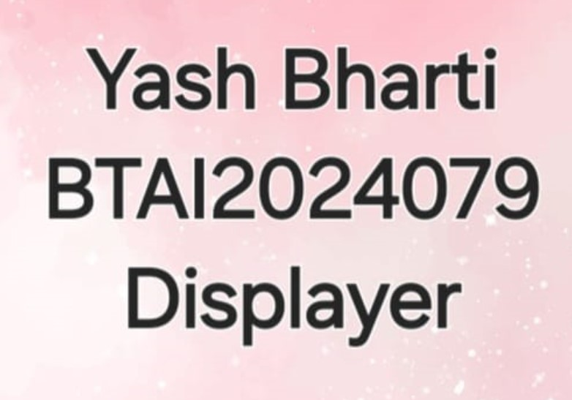
About us…..
Department : Computer Science Engineering
Course : B.Tech CSE
Specialization Artificial Intelligence
Year & Semester :
1st year
2nd sem.

Slide 3

1. Introduction
2. Problem Statement
3. Solution Overview
4. System Features
5. C Programming Implementation
6. Example Use Case
7. Conclusion
8. Future Work

Slide 4
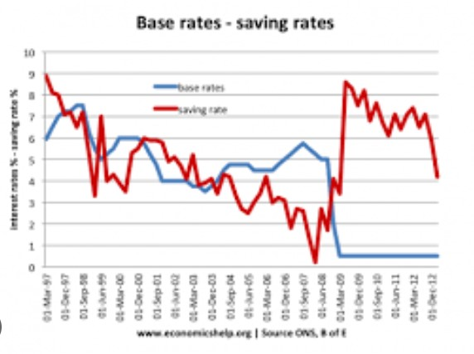


introduction…
Understand the importance of personal finance management system.
Learn how C programming can be used to create a personal finance management system.
See a demonstration of a simple personal finance management system using C programming.

Slide 5


Why Personal Finance Management is Important ?
Difficulty in tracking expenses
Inability to create a budget
Struggling to save money
High – interest debt
Encourage questions and provide thoughtful responses to enhance audience participation
Use live polls or surveys to gather audience opinions, promoting engagement and making sure the audience feel involved

Slide 6
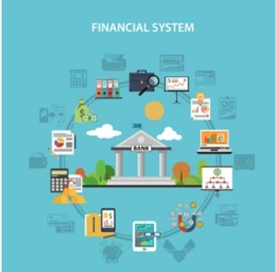

Personal finance management system
Track income and expenses
Create a budget
Set financial goals
Monitor progress

Slide 7
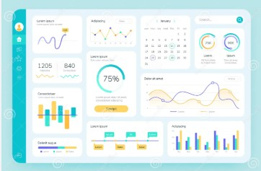
Key features of the personal finance management system
User – friendly interface
Expense tracking
Budgeting
Goal setting
Progress monitoring
MARKET RESEARCH
USER TESTING
Q4
Q2
Q3
Q1
PRODUCT DEVELOPMENT
PRODUCT LAUNCH

Slide 8

C PROGRAMMING IMPLEMENTATION

Slide 9


Financial overview
User wants to track their expenses for the month.
User adds transactions for income and expenses.
System calculates total income and expenses.
System provides a summary of the user’s finances.

Slide 10


CONCLUSION…
Quarter | Revenue growth (%) | Market share increase (%) | Customer acquisition
Q1 | 12 | 2 | 500
Q2 | 15 | 3 | 600
Q3 | 18 | 4 | 700
Q4 | 20 | 5 | 800
Personal finance management is important for financial stability.
The personal finance management system provides a simple and effective way to track income and expenses.
The system is implemented using C programming.

Slide 11
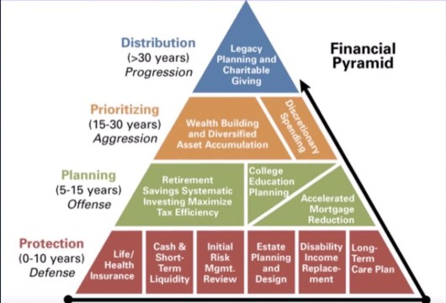
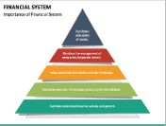
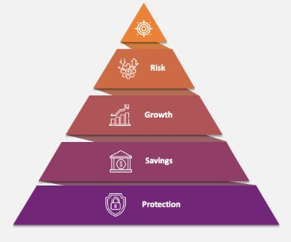
Future work…
* Add more features, such as budgeting and goal setting.
*Implement data encryption for security.
*Create a graphical user interface.
Metric | Current value | Previous quarter | Change (%)
Revenue | $2,500,000 | $2,200,000 | +14%
Operating expenses | $1,200,000 | $1,400,000 | -14%
Net profit | $1,000,000 | $800,000 | +25%
Operating margin | 40% | 36% | +4%
Cash reserves | $5,000,000 | $4,500,000 | +11%

Slide 12


THANK
YOU

